Slide 1

Object-Oriented Software Analysis & Design (COMP-3220) Lecture 4 Factory Pattern
School of Computer Science
Faculty of Science
University of Windsor
Dr. Saeed Samet

Slide 2
Big Data Analytics and Database Design
Intent
The Factory Pattern provides an interface for creating objects while allowing subclasses or factory methods to decide which concrete class to instantiate.
Instead of creating objects directly using new, object creation is delegated to a factory.
Encapsulating the object creation process
Reducing coupling between clients and concrete classes

Slide 3
Abstract Factory

Slide 4
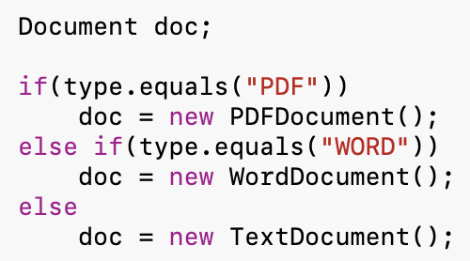
Big Data Analytics and Database Design
Motivation
Suppose you are developing a document editor that supports:
PDF documents
Word documents
Text documents
Without a factory, client code would be something like:
Problems:
Client code knows all concrete classes.
Adding a new document type requires modifying existing code.
Object creation logic becomes scattered throughout the system.
The Factory Pattern centralizes object creation.

Slide 5
Big Data Analytics and Database Design
Problems It Solves
Encapsulates object creation.
Reduces coupling between client and concrete classes.
Simplifies object instantiation.
Supports Open/Closed Principle.
Makes systems easier to extend.

Slide 6
Big Data Analytics and Database Design
Real-Life Analogy
Imagine ordering a drink at a restaurant.
You simply say: “I would like a coffee.”
You do not know:
Which machine is used
How it is prepared
Which ingredients are selected
The kitchen (factory) creates the appropriate object and returns it.
The customer interacts with the final product, not the creation process.

Slide 7
Big Data Analytics and Database Design
Factory Pattern Structure
Main Participants
Product
Defines a common interface.
Concrete Products
Implement the Product interface.
Factory
Creates Product objects.
Client
Requests products from the factory.

Slide 8
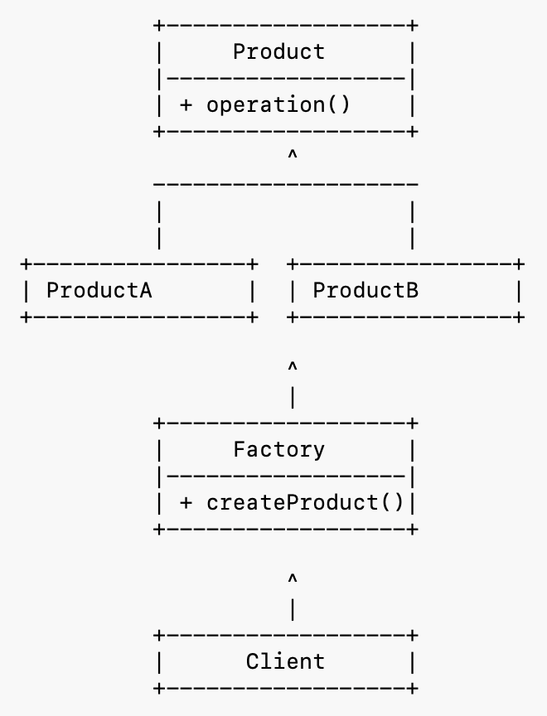
Big Data Analytics and Database Design
UML Structure

Slide 9
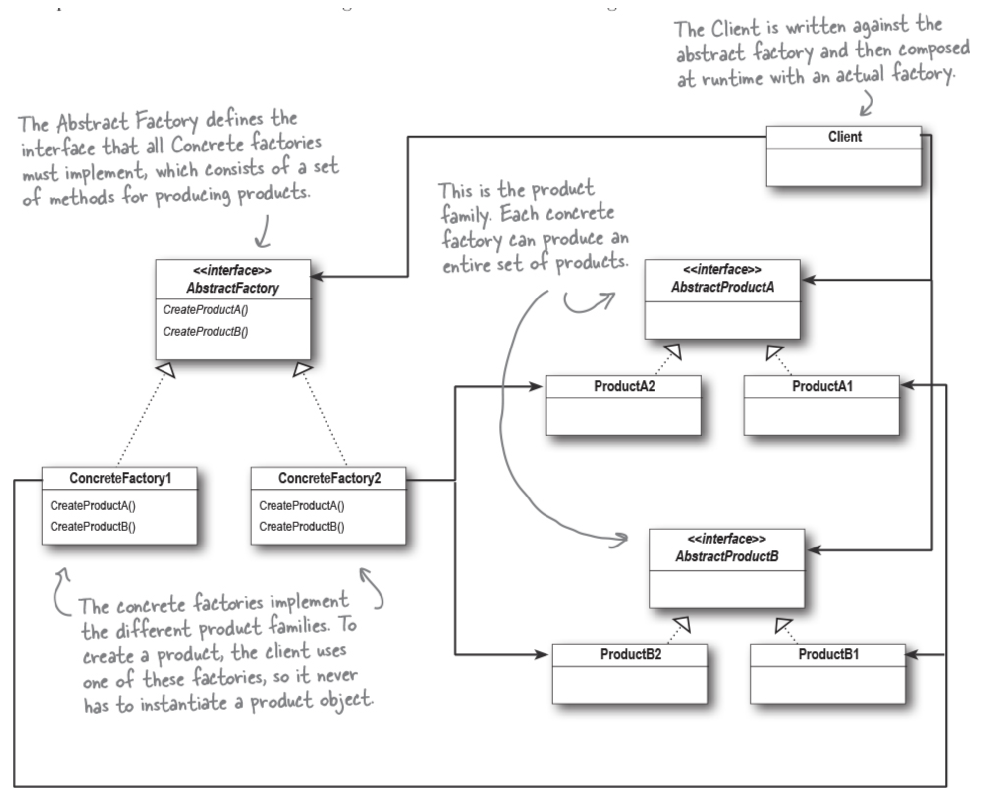
Big Data Analytics and Database Design
Factory Pattern – Class Diagram

Slide 10
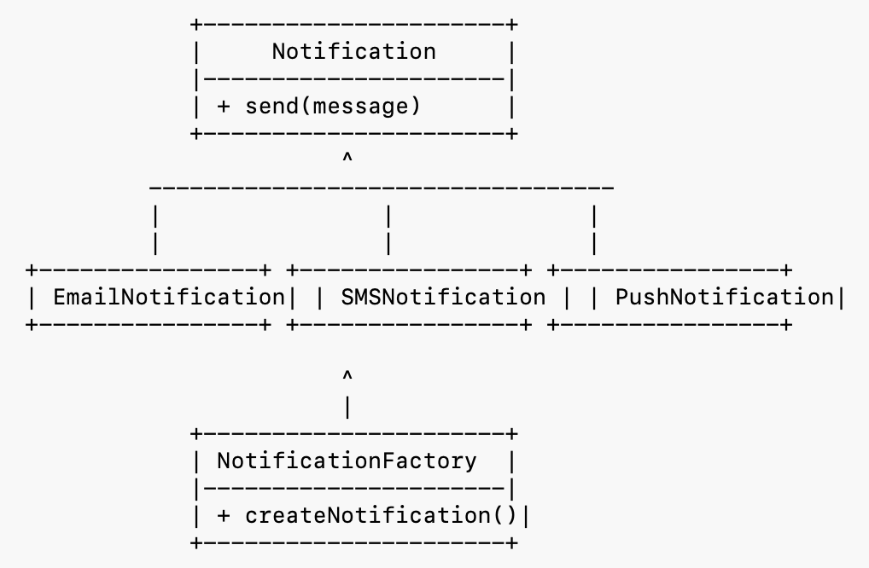
Big Data Analytics and Database Design
Example: Notification System
Suppose an application sends notifications through:
Email
SMS
Push Notification
The client should not directly create notification objects. Instead, it asks a factory.

Slide 11
Big Data Analytics and Database Design
How It Works
Client requests a notification type
Factory receives the request
Factory creates the correct object
Factory returns Notification
Client uses Notification interface

Slide 12
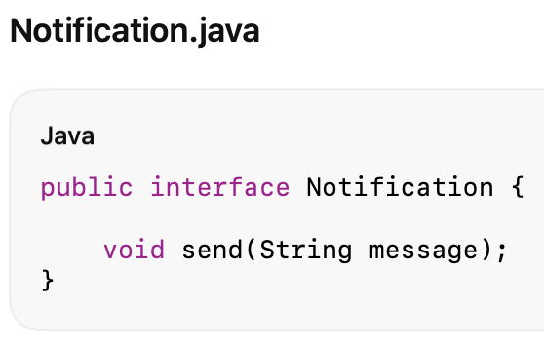
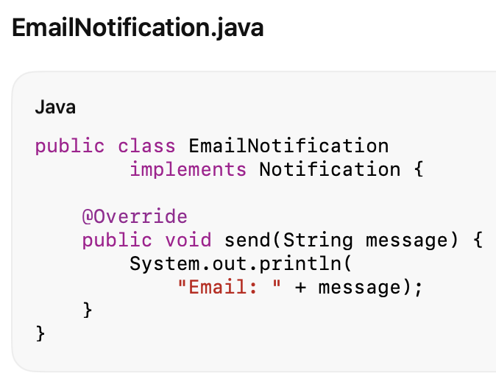
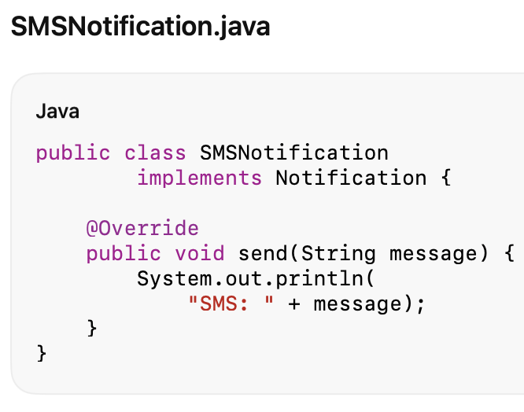
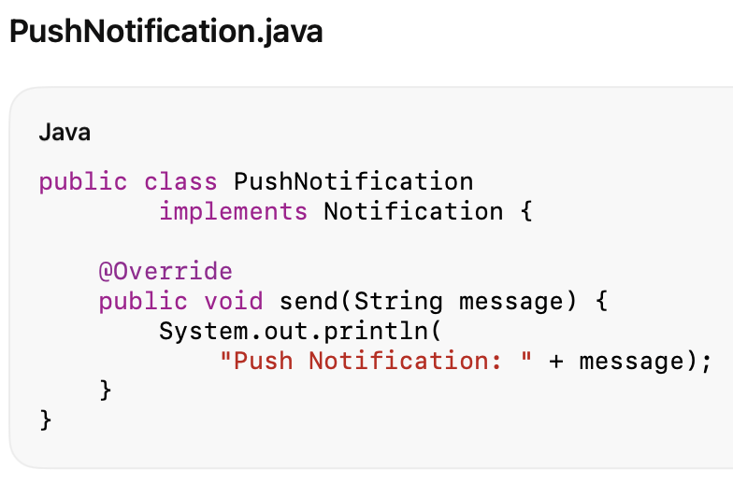
Big Data Analytics and Database Design
Java Code

Slide 13
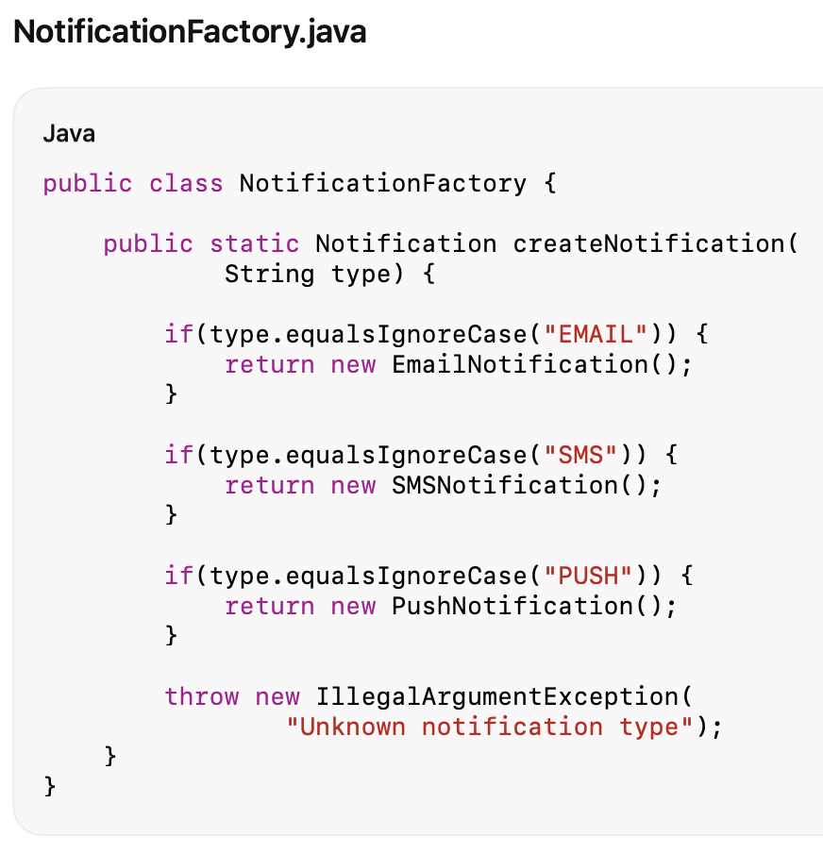
Big Data Analytics and Database Design
Java Code

Slide 14
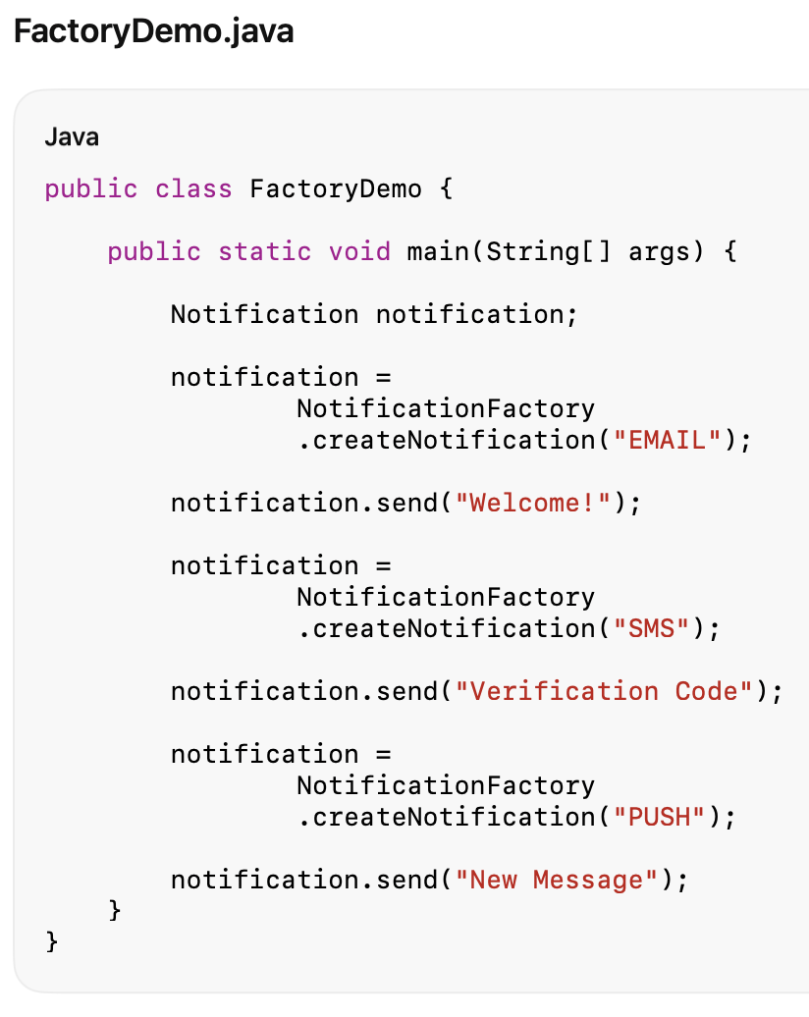
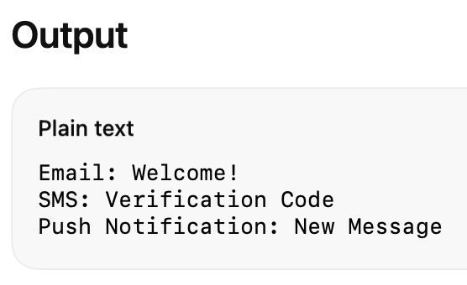
Big Data Analytics and Database Design
Java Code

Slide 15
Big Data Analytics and Database Design
Advantages
Reduces Coupling
The client depends on abstractions rather than concrete classes.
Centralizes Object Creation
Creation logic exists in one place.
Easier Maintenance
Changes to creation logic affect only the factory.
Supports Open/Closed Principle
New product types can be added with minimal impact.
Improves Readability
Instead of:
new EmailNotification();
the client uses:
NotificationFactory.createNotification("EMAIL");
Promotes Reuse
The same factory can be used throughout the application.

Slide 16
Big Data Analytics and Database Design
Disadvantages
Additional Classes
A factory introduces another abstraction layer.
Factory May Become Large
As products increase, the factory may accumulate many conditions.
Simple Cases May Not Need It
For very small systems, direct instantiation may be simpler.

Slide 17
Big Data Analytics and Database Design
When to Use Factory Pattern
Object Creation Is Complex
Creation requires logic or configuration.
Client Should Not Know Concrete Classes
You want to hide implementation details.
Many Related Objects Exist
Examples:
Documents
Notifications
Database connections
Payment processors
New Types Will Be Added Later
Factories make extensions easier.
You Want Consistent Creation Logic
All objects are created through a single mechanism.

Slide 18
Big Data Analytics and Database Design
Key Insight
The Factory Pattern encapsulates object creation and moves it out of client code.
Instead of saying:
new ConcreteProduct();
the client says:
factory.createProduct();
This reduces coupling, improves extensibility, and makes object creation easier to manage.

Slide 19
Factory Method

Slide 20
Big Data Analytics and Database Design
Intent
The Factory Method Pattern defines an interface (or abstract method) for creating an object, but lets subclasses decide which concrete class to instantiate.
In other words:
Object creation is delegated to subclasses.
The Factory Method Pattern allows a class to defer instantiation to its subclasses.

Slide 21
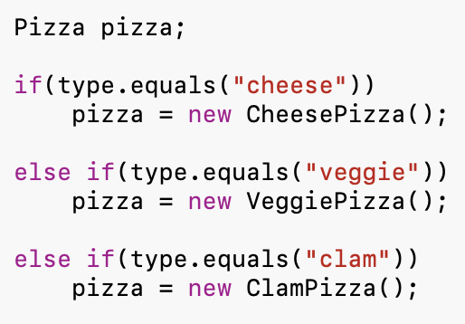
Big Data Analytics and Database Design
Motivation
Suppose you are developing a Pizza Store application.
Initially, you have:
Problems:
Client code depends on concrete pizza classes.
New pizza types require modifying existing code.
Different stores (New York, Chicago, California) may create pizzas differently.
We want to separate:
Ordering a pizza
Creating a pizza
Factory Method achieves this separation.

Slide 22
Big Data Analytics and Database Design
Problems It Solves
Encapsulates object creation.
Reduces coupling between clients and concrete products.
Eliminates large object-creation conditionals.
Supports Open-Closed Principle.
Allows subclasses to customize object creation.

Slide 23
Big Data Analytics and Database Design
Real-Life Analogy
Pizza Franchise
Imagine a pizza franchise with stores in different cities.
A customer orders:
Cheese Pizza
The ordering process is the same everywhere:
Order
Prepare
Bake
Cut
Box
However, the actual pizza created depends on the store:

Slide 24
Big Data Analytics and Database Design
Real-Life Analogy
Pizza Franchise
New York Store
Creates:
NYCheesePizza
NYVeggiePizza
Chicago Store
Creates:
ChicagoCheesePizza
ChicagoVeggiePizza
The customer interacts with PizzaStore
but each store decides which pizza objects to create.

Slide 25
Big Data Analytics and Database Design
Factory Method Pattern Structure
Participants
Product
Defines the common interface.
Concrete Products
Specific implementations of Product.
Creator
Declares the Factory Method.
Concrete Creators
Override the Factory Method to create specific products.
Client
Uses the Creator interface.

Slide 26
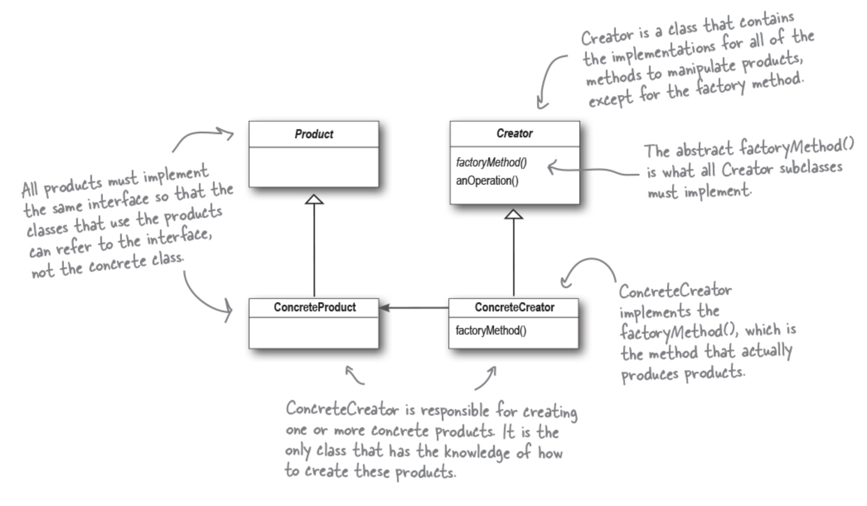
Big Data Analytics and Database Design
Factory Method Pattern – Class Diagram

Slide 27
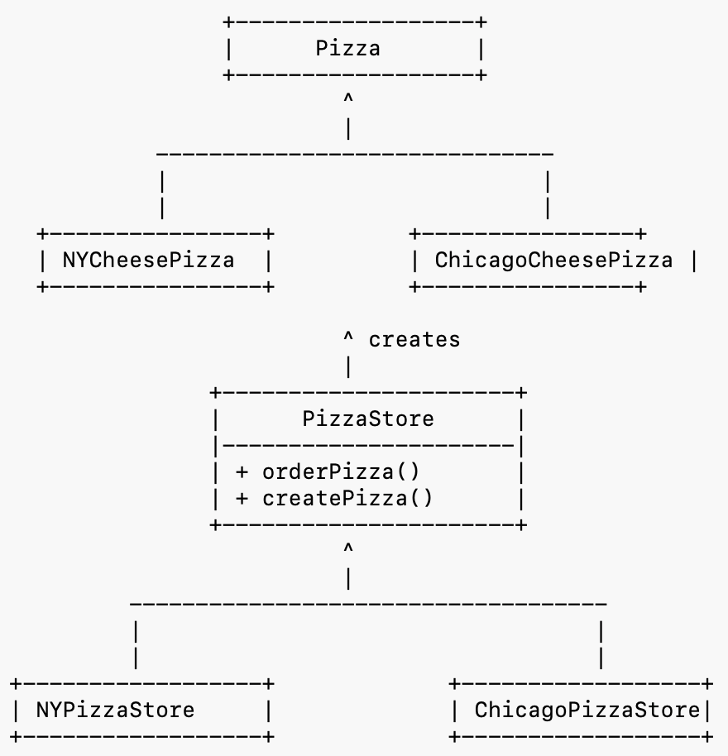
Big Data Analytics and Database Design
UML Structure

Slide 28
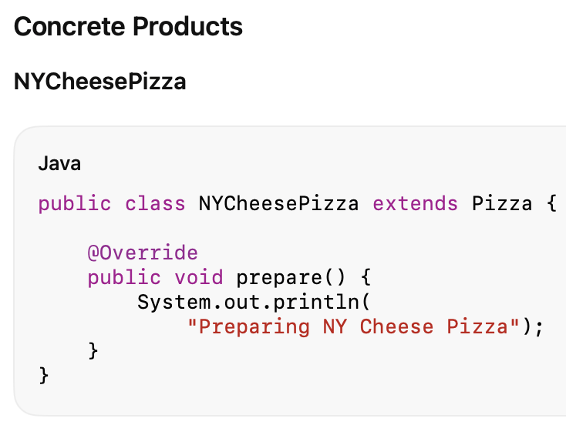
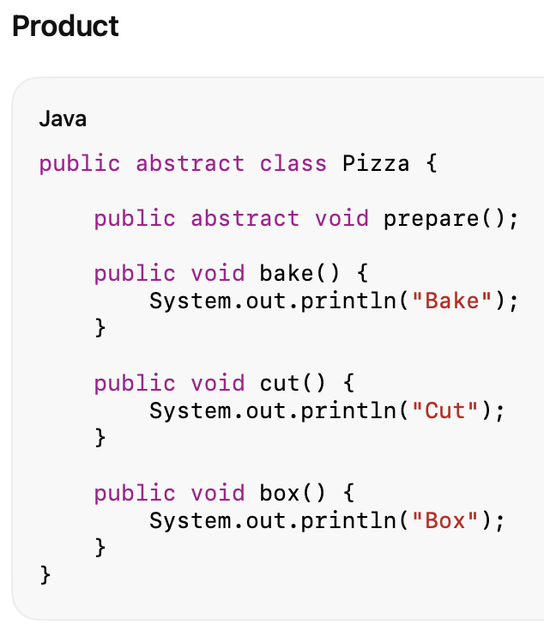
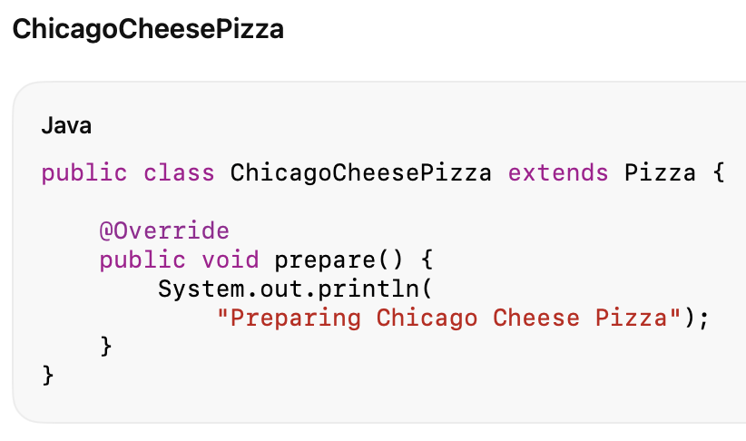
Big Data Analytics and Database Design
Java Code

Slide 29
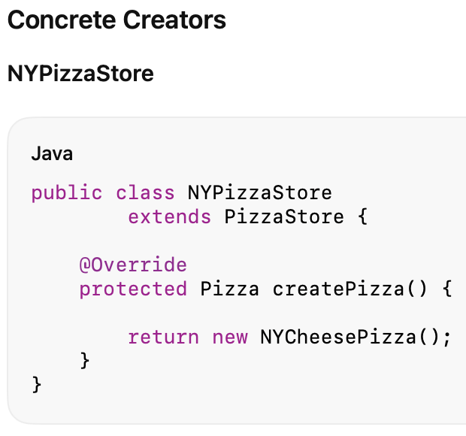
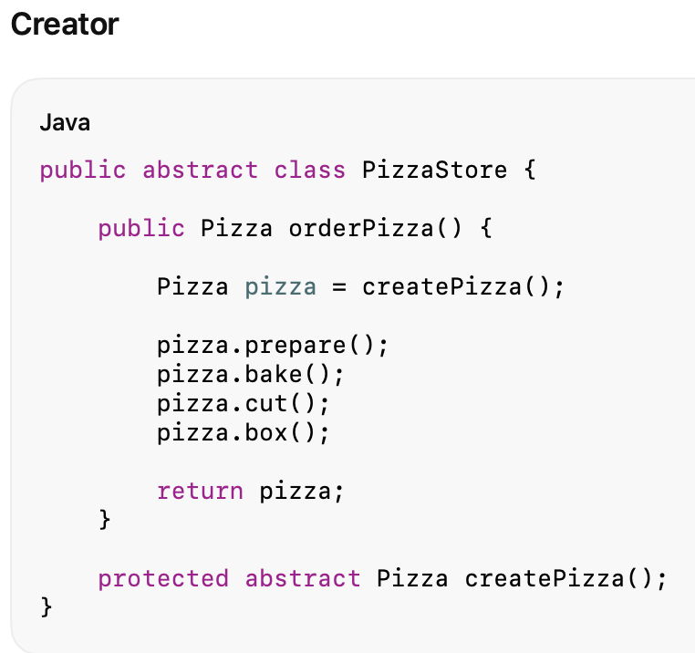
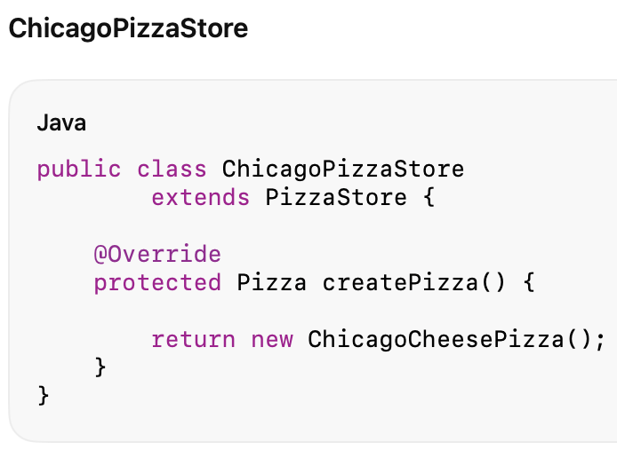
Big Data Analytics and Database Design
Java Code

Slide 30
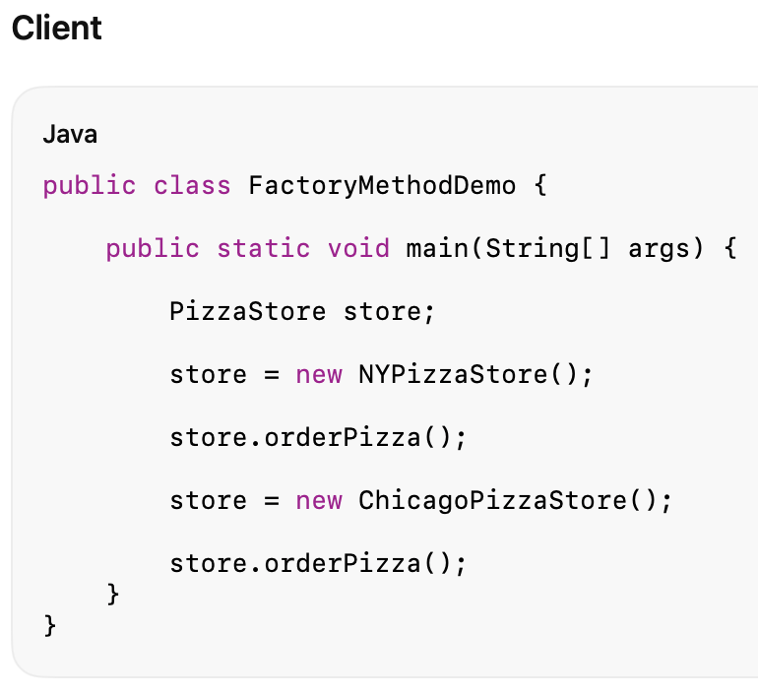
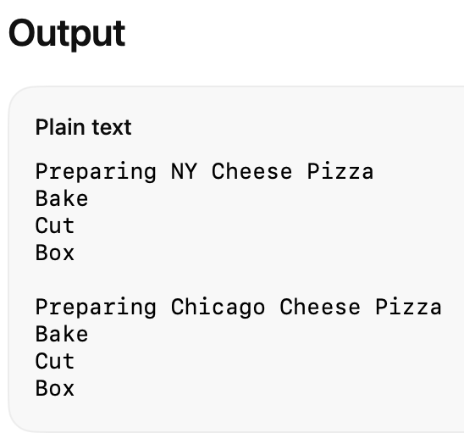
Big Data Analytics and Database Design
Java Code

Slide 31
Big Data Analytics and Database Design
How It Works
Client chooses a PizzaStore
Client calls:
orderPizza()
orderPizza() calls:
createPizza()
Concrete store overrides
createPizza()
Correct pizza object is created
Common ordering process executes

Slide 32
Big Data Analytics and Database Design
Advantages
Reduces Coupling
Clients depend on abstractions rather than concrete classes.
Supports Open-Closed Principle
New products can be added through new subclasses.
Encapsulates Object Creation
Creation logic is isolated from business logic.
Promotes Reuse
The Creator class contains common behavior.
Example: orderPizza() is reused by all stores.
Uses Polymorphism
Different creators can produce different products.

Slide 33
Big Data Analytics and Database Design
Disadvantages
More Classes
Each product type may require a corresponding creator subclass.
Increased Complexity
The inheritance hierarchy may grow large.
Harder to Understand Initially
Students often find Factory Method more complex than a Simple Factory.

Slide 34
Big Data Analytics and Database Design
When to Use Factory Method Pattern
A class cannot anticipate which objects it must create
Subclasses should decide object creation
Object creation varies among implementations
You want to remove large if-else creation logic
You need a framework that allows customization through inheritance

Slide 35
Big Data Analytics and Database Design
Key Insight
The Factory Method Pattern says:
“Let subclasses decide what object to create.”
The Creator defines when an object is created, while subclasses define which object is created.

Slide 36
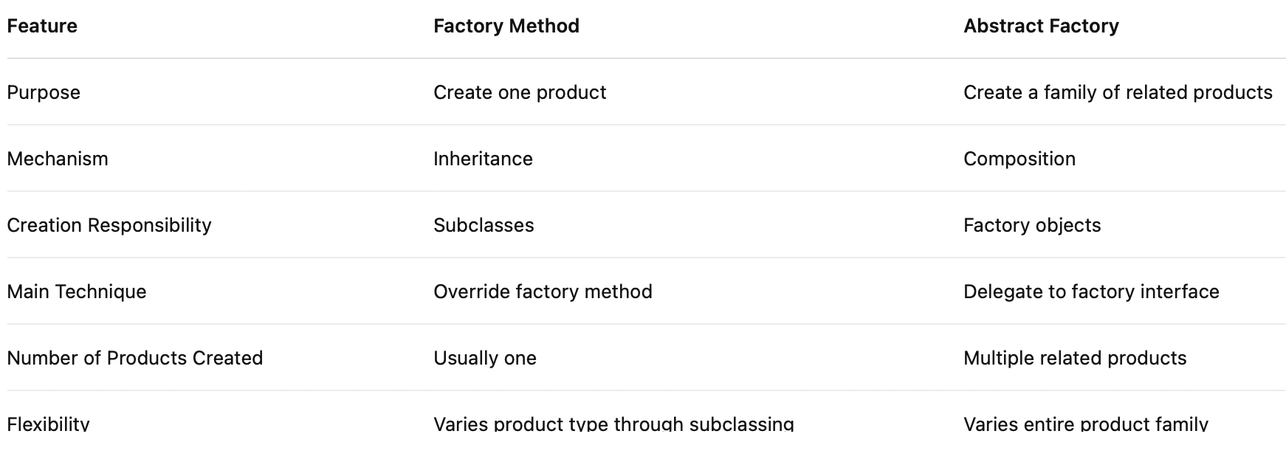
Big Data Analytics and Database Design
Factory Method vs Abstract Factory
Simple Memory Trick
Factory Method
One method creates one product.
Abstract Factory
One factory creates many related products.

Slide 37
Big Data Analytics and Database Design
Factory Method vs Abstract Factory
Factory Method focuses on
creating a product through inheritance
whereas
Abstract Factory focuses on
creating families of related products through composition.

